Slide 1
I’m Not Lazy, I’m a Visionary
The history of computing
By Matthew D. Groves
Most images licensed through Creative Commons
Notes:
z

Slide 2
Dedicated to Grace
Notes:
Not Grace Hopper

Slide 3
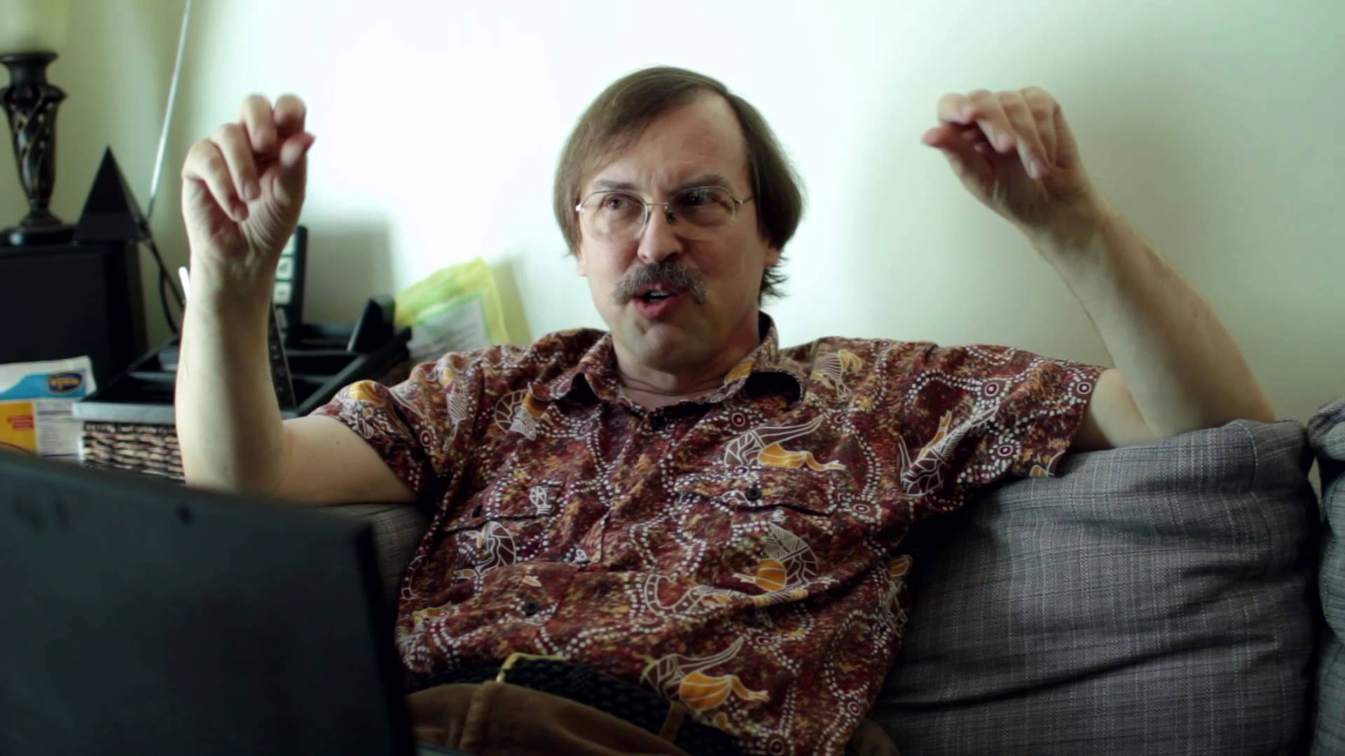
Image licensed through Creative Commons: https://www.youtube.com/watch?v=aNAtbYSxzuA

Slide 4
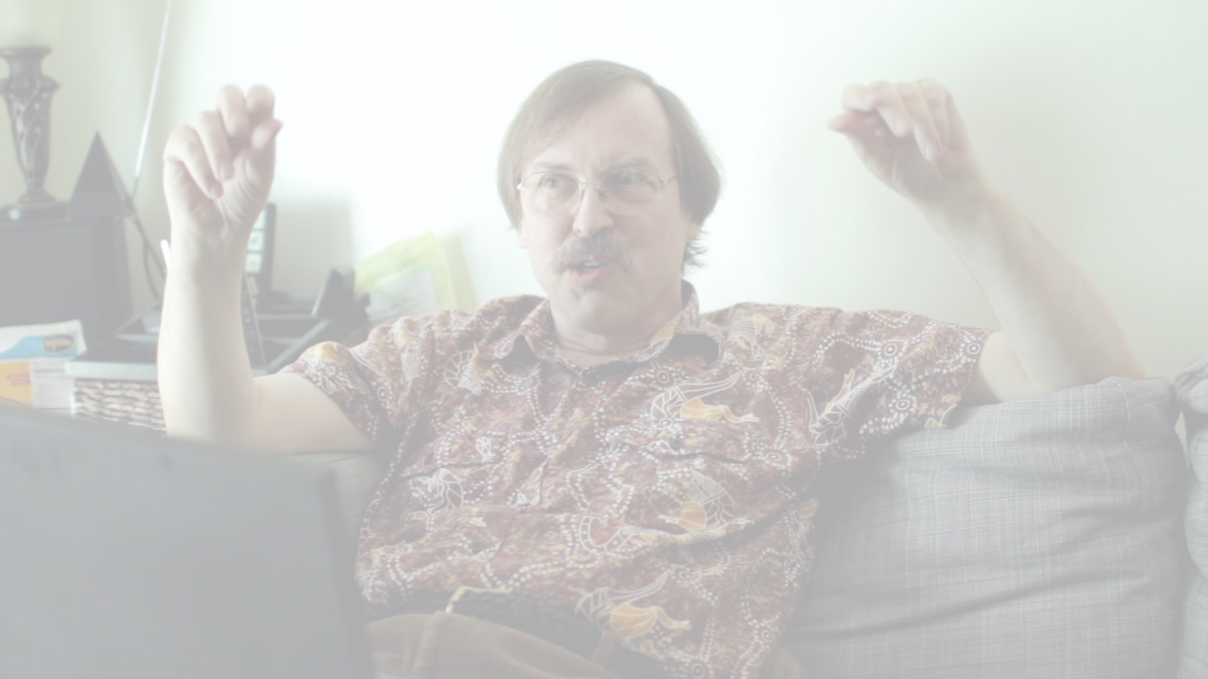
“We will encourage you to develop the three great virtues of a programmer: laziness, impatience, and hubris.”
– Larry Wall, Programming Perl
Image licensed through Creative Commons: https://www.youtube.com/watch?v=aNAtbYSxzuA

Slide 5
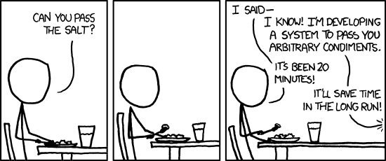
http://xkcd.com/974/

Slide 6
Matthew D. Groves
I’ve been writing code since I was 8
Software Developer with Heuristic Solutions
I mainly work with .NET, but I also work with JS, PHP, mobile, etc
BS, MBA, PostSharp MVP, Microsoft MVP
“I am not an expert, but I am an enthusiast!” – Alan Stevens
Notes:
NOT AN EXPERT: Please know that there is a lot of missing pieces. I’ve crammed hundreds of years into an hour, and in some cases I’ve cherry-picked on some relatively minor details. Please don’t think of this as a complete history; please think of it as a starting point. Hopefully something in this session will pique your interest and encourage you start looking into history yourself.

Slide 7

http://manning.com/groves

Slide 8

http://commons.wikimedia.org/wiki/File:History_Logo.svg
Notes:
Why history? It’s all in the past and CodeMash is about looking toward the future!
I believe that by looking at areas orthogonal to our expertise (programming, coding), we can learn concepts that we can bring back and apply.
Economics. Religion. Operations. We can cherry pick stuff that’s useful to us. And I think History too.

Slide 9

Notes:
I’m not a historian.
Where did this come from?
I have a blog, and I made it a goal to write 3 blog posts a week in 2014. I didn’t make it because of reasons.
I needed material, so I decided to write brief bios. Go deeper than Wikipedia, but keep it to blog post length.
As I did this, I started to see some patterns emerge.

Slide 10
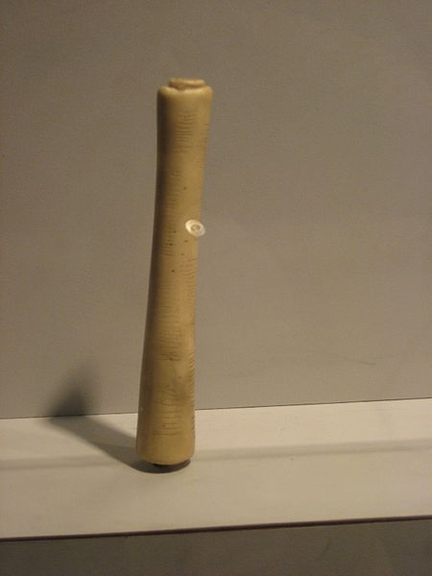
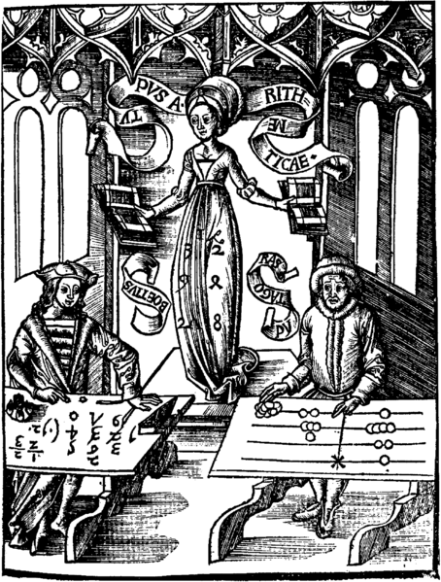
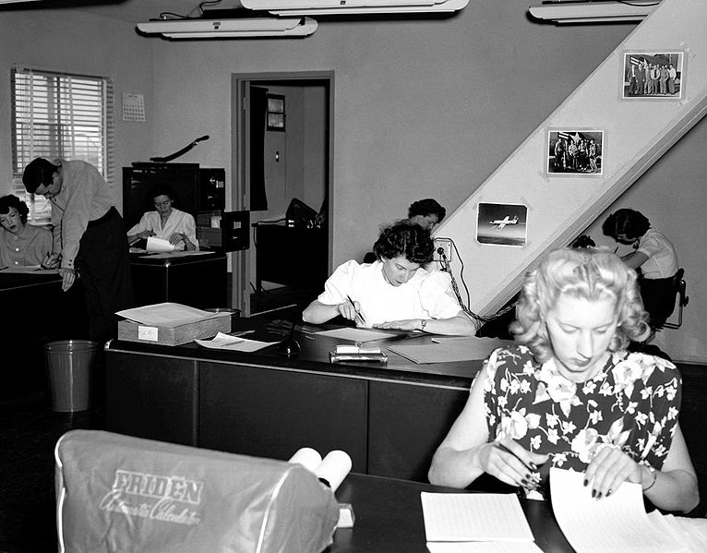
Computing: When to start?
Ishango Bone: 8500 B.C.
Madame Arithmatica: 1508 A.D.
Computers at work: 1949
http://commons.wikimedia.org/wiki/File:Ishango_Bone.jpg
http://commons.wikimedia.org/wiki/File:Gregor_Reisch,_Margarita_Philosophica,_1508_(1230x1615).png
http://en.wikipedia.org/wiki/File:Human_computers_-_Dryden.jpg
Notes:
It’s hard to draw a line as the “start” of computing
Computing can be tied to prehistory through math.
Ishango bone: tally stick, numeric system, or perhaps a mathematical tool
Madame Arithmatica: an abacus
Until the 20th century, a “computer” was a job title for a person.

Slide 11
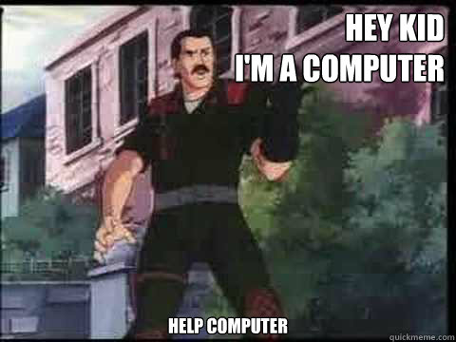
Notes:
You could literally say “HEY KID I’M A COMPUTER”
---

Slide 12
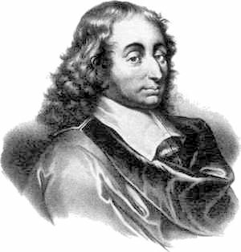
Blaise Pascal (1623 – 1662)
http://commons.wikimedia.org/wiki/File:Blaise_pascal.jpg
Notes:
You’ve probably heard of Pascal. He made huge contributions to mathematics, philosophy, religion, physics, etc. And you’ve probably heard of the Pascal programming language.
He also made some early contributions to mechanical computing because he was lazy.
Blaise’s father was the king’s commissioner of taxes
1642: 18-year-old Blaise was conscripted by his father into helping with tax calculations. He didn’t like this tedious work, so he built the Pascaline. (LAZY)

Slide 13
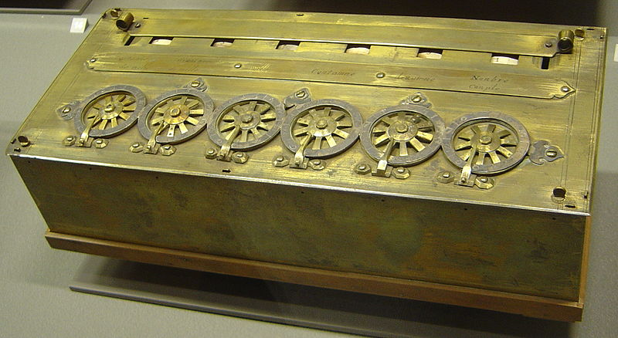
Pascaline
http://commons.wikimedia.org/wiki/File:Arts_et_Metiers_Pascaline_dsc03869.jpg
Notes:
Pascaline
Machine to do addition and subtraction
He built this calculator because he was lazy.
And talk about hubris? He named the darn thing after himself.
It basically works like an odometer. You just dial in any number of addends and you’ll get a running sum.
You can also perform subtraction with 9’s complements.
All of this to get out of tedious work for his father.

Slide 14
Point #1
Laziness is only virtuous if it has a productive purpose.
Notes:
Getting out of work = lazy.
Getting out of work by building a device to do it or eliminate it = virtuous.

Slide 15
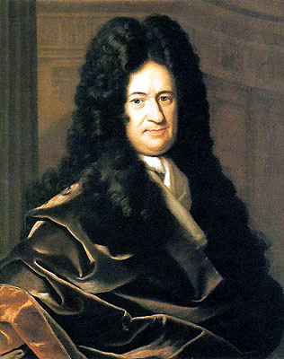
Gottfried Wilhelm Leibniz (1646 – 1716)
http://commons.wikimedia.org/wiki/File:Gottfried_Wilhelm_von_Leibniz.jpg
Notes:
You’ve probably heard of Leibniz too. He made contributions to physics, geology (he thought that earth had a molten core), engineering, lawyer, studied Chinese culture, mathematics, philosophy.
Invented calculus

Slide 16
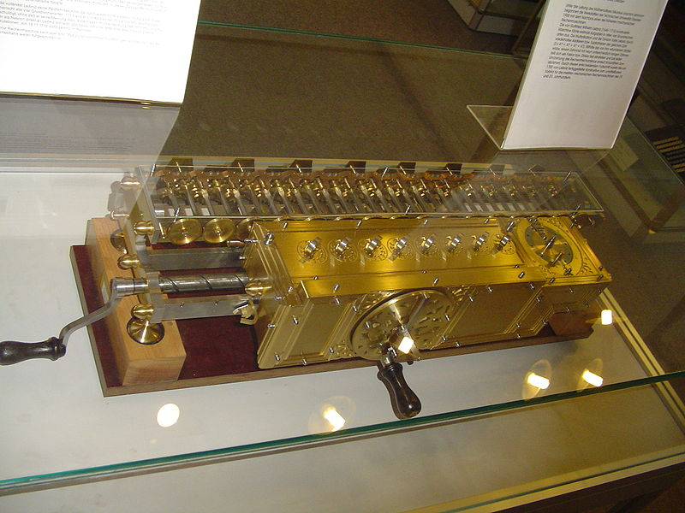
Stepped Reckoner
http://commons.wikimedia.org/wiki/File:Leibnitzrechenmaschine.jpg
Notes:
Leibniz was exposed to the Pascaline and thought it was cool. He made his own calculating machine.
He also designed a “Stepped Reckoner”, or Leibnitz “rechenmaschine” in German, but never built one.
When it came to calculation, he said: “It is beneath the dignity of excellent men to waste their time in calculation when any peasant could do the work just as accurately with the aid of a machine.”

Slide 17
Point #2
Your time is valuable. Don’t waste it on something that could be scripted instead.
Notes:
The sooner the better, because it’s going to get harder the more you put it off.

Slide 18
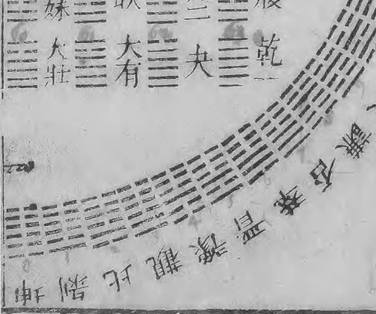
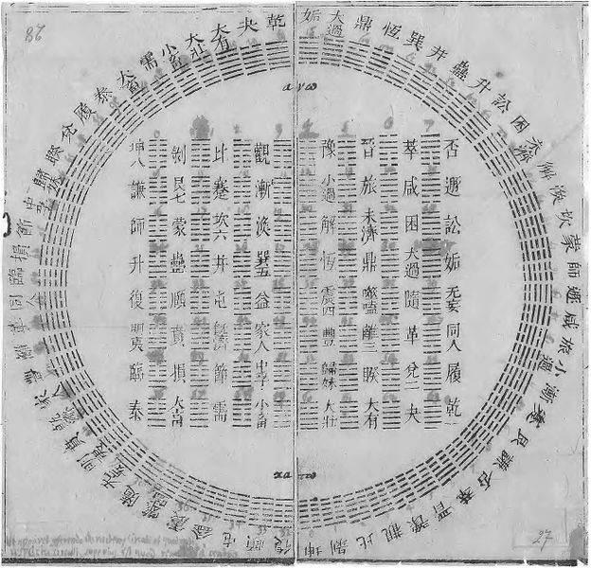
Binary Numbers
http://en.wikipedia.org/wiki/File:Diagram_of_I_Ching_hexagrams_owned_by_Gottfried_Wilhelm_Leibniz,_1701.jpg
Notes:
Because he was a mathematician and studied Chinese culture
He was interested in finding/creating a ‘universal language’. He believed that the binary number system was that language, and that some day all communications would be in binary
HUBRIS: writing system/language to solve all problems of ethics and metaphysics

Slide 19
Point #2b
Look around. Explore.
Notes:
Not related to laziness, but I think it’s important.
Example: listen to podcasts like Hanselminutes and .NET Rocks, but also listen to podcasts about economics, business, graphic design.
99% Invisible.
EconTalk
Industry Standard

Slide 20
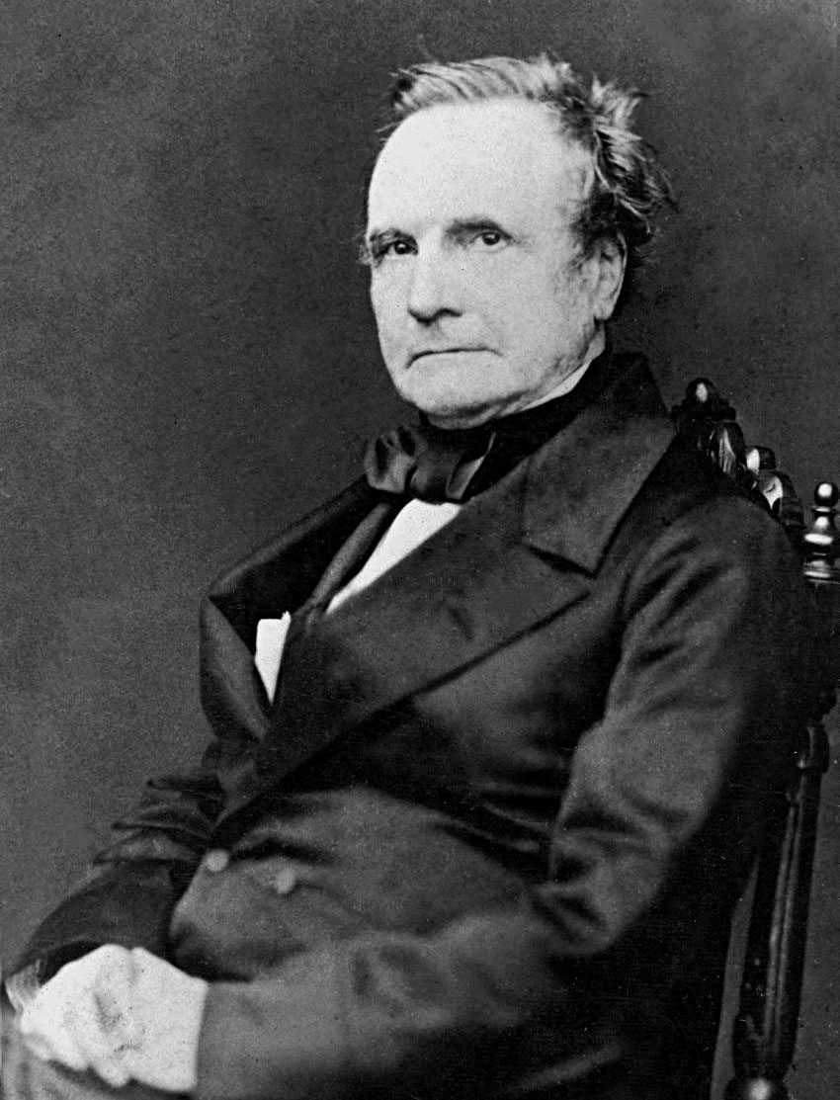
Charles Babbage (1791-1871)
http://commons.wikimedia.org/wiki/File:Charles_Babbage_-_1860.jpg
Notes:
Babbage was a mathematician and pioneer of the industrial age.
With steam power, huge economic advantages were starting to happen and Babbage was at the forefront, figuring out engineering, operations principles, division of labor. He cared very much about efficiency, and using technology to obtain it.
He was also an astronomer, inventor, and a cryptographer.
He had a real disdain for “the mob” and “street nuisances”. A quote: “It is difficult to estimate the misery inflicted … upon multitudes of intellectual workers by the loss of their time, destroyed by organ-grinders and other similar nuisances.”

Slide 21
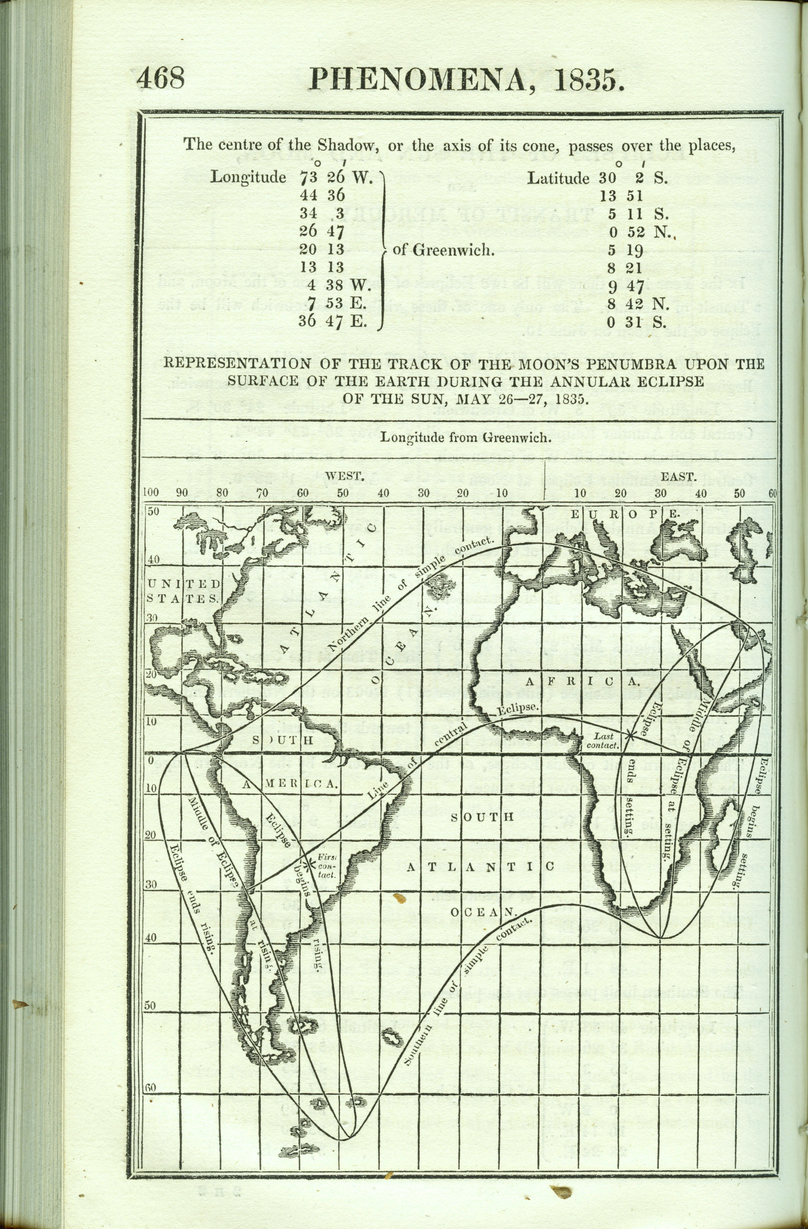
The Nautical Almanac
http://eclipse-maps.com/Eclipse-Maps/History/Pages/1801-1850.html
Notes:
He was a member of the Royal Astronomical Society
They wished to improve calculations published in The Nautical Almanac.
You might be thinking: star charts? Who cares?
Well, there’s no GPS or radar, so on a ship, you navigate by star.
Creating this almanac was tedious: lots of boring calculations.
Also, it was inaccurate, since all calculations were done by computers (humans).

Slide 22
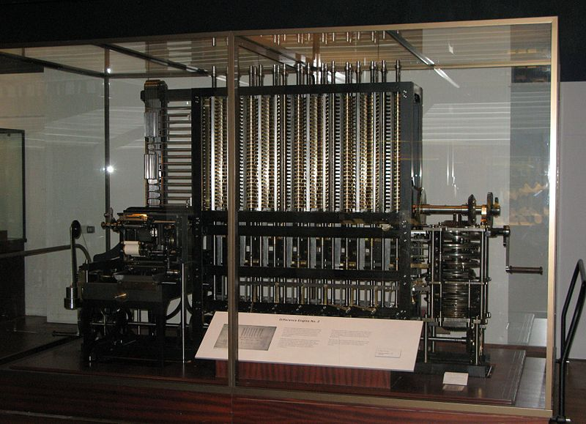
Difference Engine
http://commons.wikimedia.org/wiki/File:Babbage_Difference_Engine.jpg
Notes:
LAZY: Create the Difference Engine to do the calculations
Babbage wasn’t the first to have this idea, but he was the first to get funding. He went over budget because no one had ever built something like this before. Babbage was mad that the government didn’t care about the machine, only the star charts.
During his work on the difference engine, he was distracted, because he got even lazier…

Slide 23
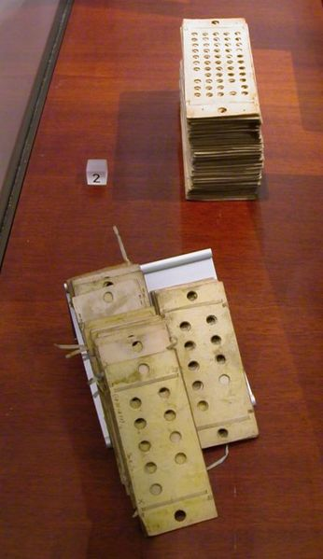
Analytical Engine
http://commons.wikimedia.org/wiki/File:PunchedCardsAnalyticalEngine.jpg
Notes:
And decided to work on the Analytical Engine. Why build a difference engine that can just do one task, when you can make a better abstraction?
A more general purpose machine that could be used for multiple tasks (and HUBRIS and IMPATIENCE)

Slide 24
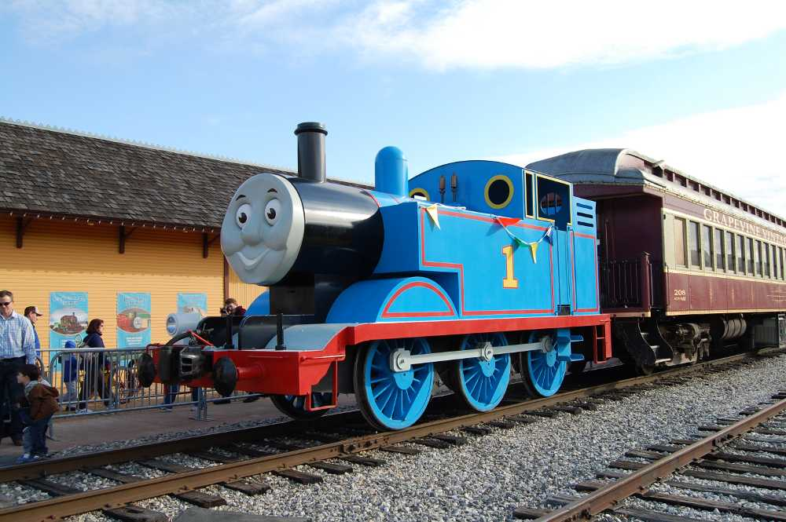
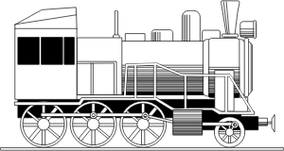
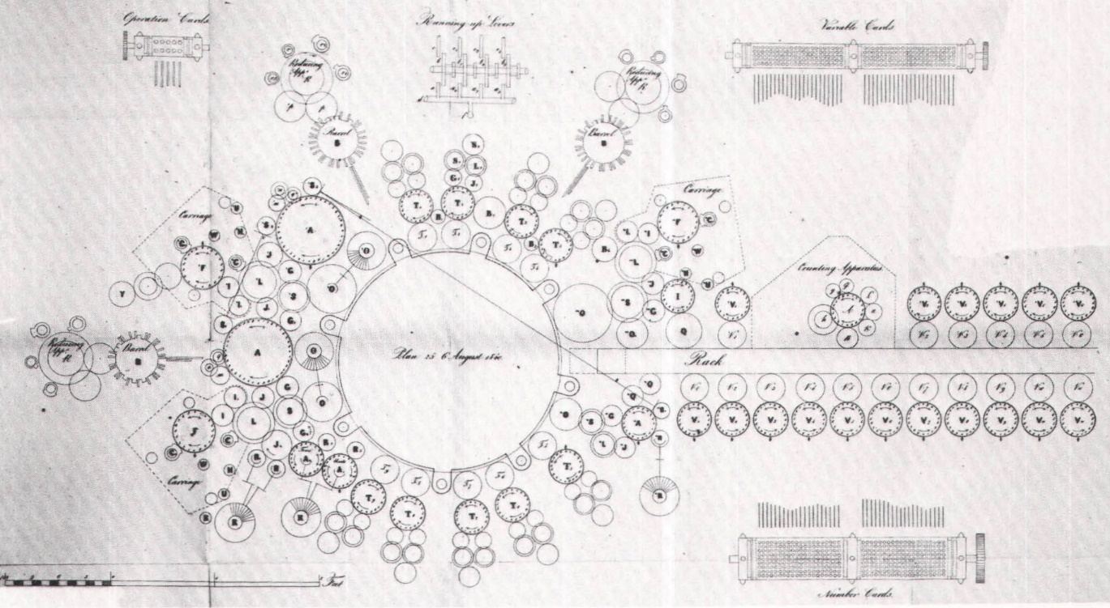
Analytical Engine
http://ds.haverford.edu/bitbybit/wp-content/uploads/2012/07/Chapter_2-55.jpg
https://openclipart.org/image/300px/svg_to_png/70039/Retro_locomotive.png
https://www.flickr.com/photos/grapevinetxonline/4531029896/
Notes:
John Graham-Cumming is working to get a full analytical engine built, and it will actually run Babbage’s old programs

Slide 25
Moore and Babbage
Pentium II
Apple II
Collossus
Analytical Engine
http://www.docstoc.com/docs/97075031/Download-the-Excel-Spreadsheet-Moore-s-Law-Year
Notes:
John Graham-Cumming says analytics engine would be around 7hz of processor cycle speed.
That’s HERTZ not megahertz.
Here’s roughly where it would be in relation to other well known computers. And note that this chart is on a logarithmic scale otherwise it wouldn’t be very interesting to look at.
X-axis = calculations per second per $1000

Slide 26
Point #3
Listen to your annoyance.
Notes:
When you find yourself saying “ugh, this is so annoying”, think about what you wish it would be like, and then think about how you can get there.

Slide 27
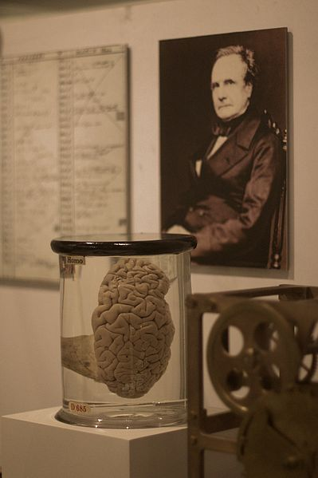
BABBAGE BRAAaaaAAaaaINNSSSS
http://en.wikipedia.org/wiki/File:Babbages_Brain.jpg
Notes:
Charles Babbage’s brain is ON DISPLAY in London at: The Hunterian Museum in the Royal College of Surgeons

Slide 28
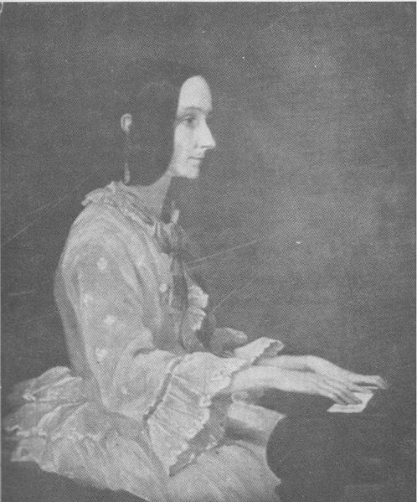
Ada Lovelace (1815 – 1852)
http://commons.wikimedia.org/wiki/File:Ada_Lovelace_in_1852.jpg
Notes:
Can’t really talk about Babbage without mentioning Lovelace
With the little we know about her, she doesn’t fit the laziness, hubris, impatience model very well though.
She’s remarkable because she doesn’t really fit ANY mold.
Impatience: she sat for this picture was painted in the year of her death while she was in chronic pain.
Hubris: any hubris is really only historical: a woman, an aristocrat, a LADY, shouldn’t be pursuing such things
Ada met Babbage at a party and began to regularly correspond with Babbage. You might consider Babbage and Ada the first pair programmers, and Ada the first remote developer (using the post instead of RDP).
She also worked to translate Babbage’s writing and other papers based on Babbages, but “translator” is an understatement: she also acted as QA and wrote programs in “annotations”.

Slide 29
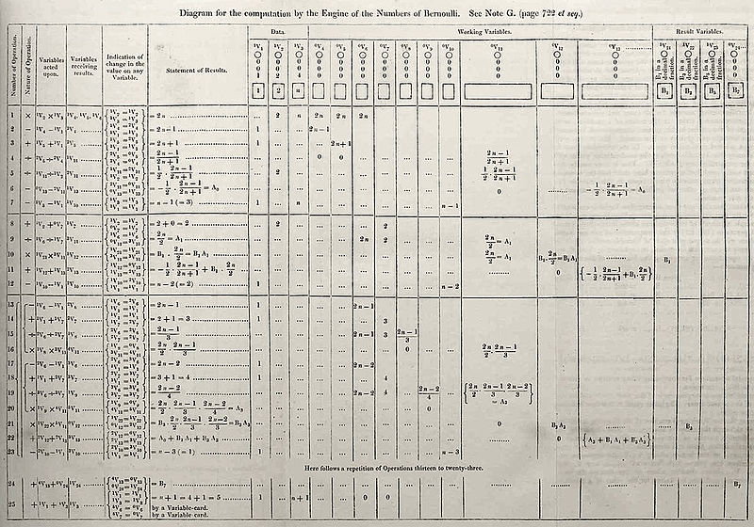
Annotation G: Bernoulli Numbers
http://commons.wikimedia.org/wiki/File:Diagram_for_the_computation_of_Bernoulli_numbers.jpg
Notes:
This is one of 7 annotations (this being annotation G) to a paper written by Luigi Menabrea. Her annotations were longer than Menabrea’s paper, which was based on a Babbage lecture, that she was translating from French.
Hubris: She sent a bug report to Babbage – telling the inventor of the first computer that “your code is wrong.”
Laziness: She loved gambling. She tried to using computing and math to run a gambling syndicate, but failed.

Slide 30
Point #4
Speak up.
Notes:
If something in your code base doesn’t seem right or you think there’s a better way, call it out.
Three possibilities:
You’ll be wrong, be corrected, educated, and you’ll learn something new quickly.
You’ll be right. What might be obvious to a new team member may be completely overlooked by the existing team.
You’ll be wrong, and your team will humiliate you and make fun of you. You’ll learn to start looking for a new team.

Slide 31
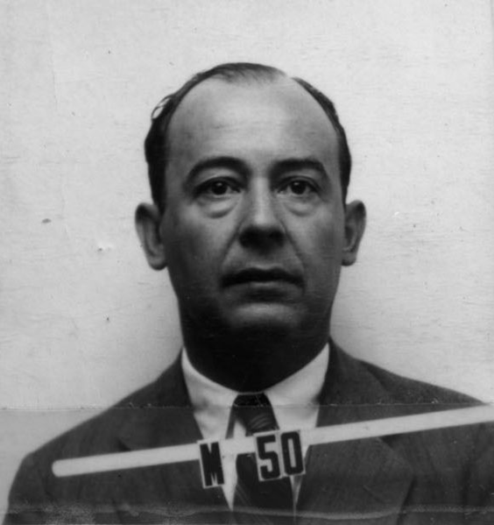
John von Neumann (1903 – 1957)
http://commons.wikimedia.org/wiki/File:John_von_Neumann_ID_badge.png
Notes:
“noy-man”
Wrote 150 published papers
Game theory
Set theory
Von Neumann Architecture, which we’ll talk more about in a little bit

Slide 32
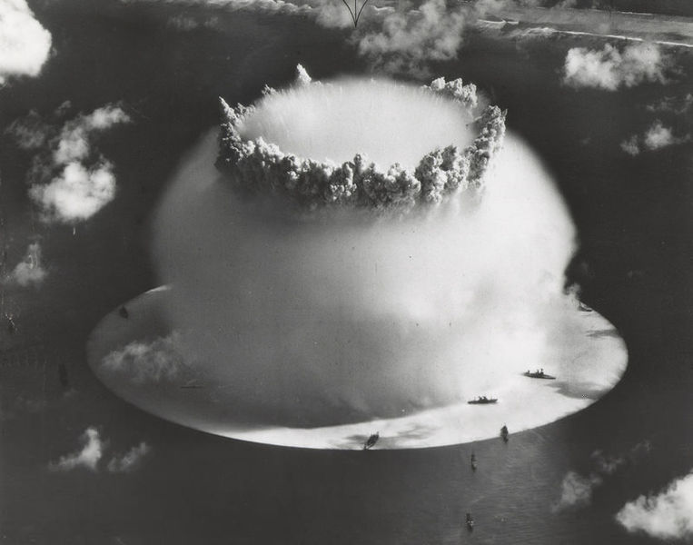
Manhattan Project
http://commons.wikimedia.org/wiki/File:Crossroads_baker_explosion.jpg
Notes:
Worked on Manhattan Project

Slide 33

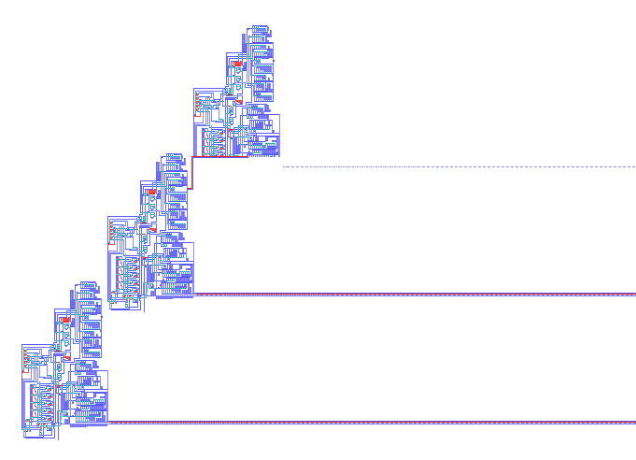
Self-replicating program
http://commons.wikimedia.org/wiki/File:Nobili_Pesavento_2reps.png
Notes:
Universal Constructor, A.k.a. computer virus
This was an abstract concept
Von Neumann took it even one step further and came up with a machine that could physically replicate itself using a room full of “spare parts” that could be accessed by the machine.
Von Neumann invented Skynet.

Slide 34
Von Neumann and the Middle-Square Method
Generate 4-digit random numbers:
Start with a 4-digit number: 1234
Square it: 01522756
Take the middle four digits: 01522756
Repeat: 5227² => 27321529 => 3215² => 10336225 => etc…
Rubbishy: 0540 => 2916 => 5030 => 3009 => 0540
Notes:
The middle-square method, invented around the year 1240 by a friar. It’s pretty rubbish. The most you can get is 8^n (4096 in this case) random numbers.
During is work on the hydrogen bomb, he used and contributed to the Monte Carlo method of simulation.
Monte Carlo uses random numbers. Even though he was criticized for it, he used this method instead of “true” random numbers
Because it was faster, and by the way, it was easier to detect when its cycle is over. When it fails, it fails hard.
"Any one who considers arithmetical methods of producing random digits is, of course, in a state of sin.”

Slide 35
Point #5
The prefect is the enemy oof the good.
Notes:
Shipping is a feature. Don’t be afraid of hacks.
One of the great geniuses of the 20th century used a hack from a 13th century monk to run hydrogen bomb simulations.
Just be intentional about the hack: know exactly what the consequences are.

Slide 36
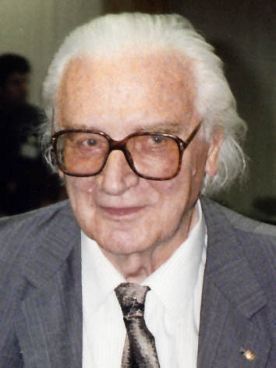
Konrad Zuse (1910 – 1995)
http://commons.wikimedia.org/wiki/File:Konrad_Zuse_(1992).jpg
Notes:
“zoo-sah”
Konrad Zuse born in Germany in 1910.
His father was a postal worker.
Schooling: considered engineering, architecture, found them boring.

Slide 37
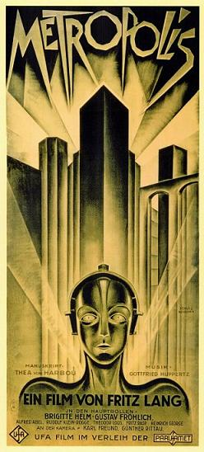
Saw a movie
http://en.wikipedia.org/wiki/File:Metropolisposter.jpg
Notes:
Wasn’t quite sure what he wanted to do with his career.
Saw a movie, thought the futuristic city was pretty rad, decided to study civil engineering.

Slide 38
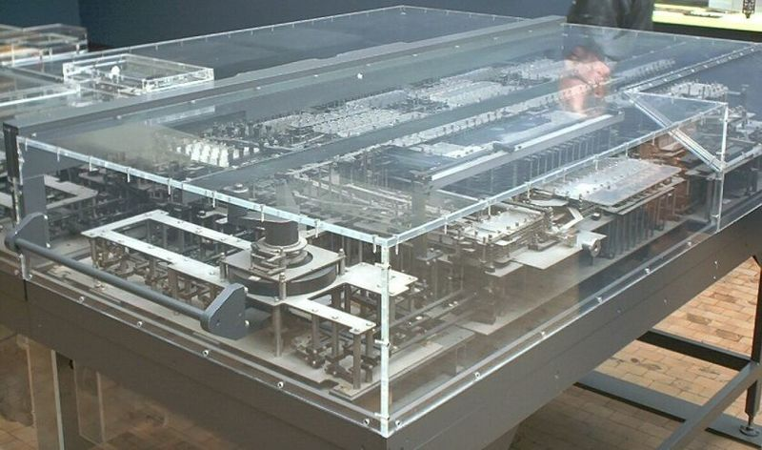
1936 in Germany
http://commons.wikimedia.org/wiki/File:Zuse_Z1.jpg
Notes:
He went to work in an aircraft factory in 1935. He found all the calculations for manufacturing airplanes very tedious.
So in 1936 Konrad Zuse created the Z1 computer in his parent’s basement.
To me, it almost looks like a scale model of a futuristic city.

Slide 39
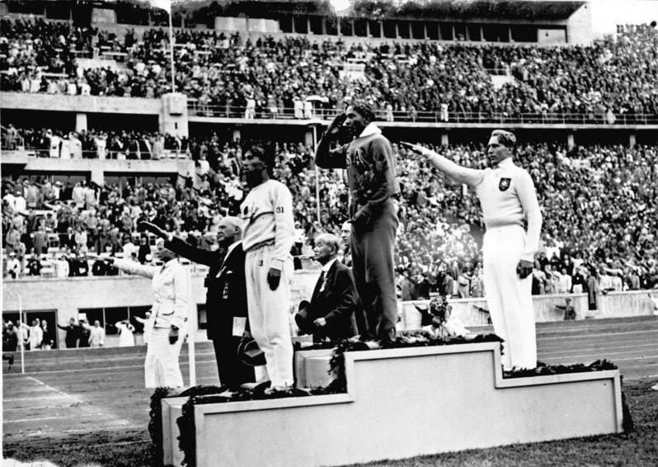
1936 in Germany
http://commons.wikimedia.org/wiki/File:Bundesarchiv_Bild_183-G00630,_Sommerolympiade,_Siegerehrung_Weitsprung.jpg
Notes:
There was some other stuff going on in Germany at the time. Zuse was somewhat isolated, so he was making these advances on his own: binary numbers, punch cards
Also the Von Neumann architecture (which he didn’t know about), which I promise you we’re going to look at later.
Konrad Zuse was actually drafted into Nazi infantry in 1939, and he told the Nazi’s that he shouldn’t be in the infantry, and the Nazi’s said…

Slide 40

Notes:
He convinced them he would be better off building a computer to build airplanes.
Imagine the guts of making such a request.
But he convinced them.

Slide 41
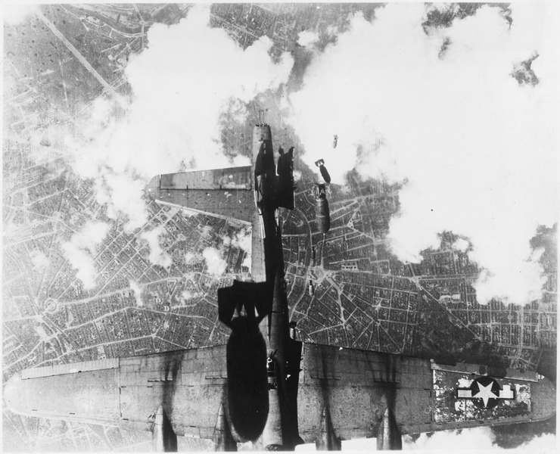
1943 in Germany
Z3 computer
http://commons.wikimedia.org/wiki/File:United_States_bombing_raid_over_a_German_city_-_NARA_-_197269.tif
Notes:
In 1943, Zuse had built the Z3, which was programmable, turing complete, used punched film for storage, used binary, and so on.
Here’s a picture of the original Z3.
But some other stuff was going on in Germany in 1943, and it was destroyed in an Allied bombing of Berlin.

Slide 42
Point #6
Be lazy, even if you’re in Nazi Germany.
You are more empowered than you think.
Notes:
You’ve been to a bunch of codemash sessions, and you’ve probably said “Yeah, this is great, but they would never let me use it where I work.”
Do you work in Nazi Germany? Are you trying to convince the Nazis to let you build a computer instead of go to the front lines?

Slide 43
Plankalkül
P1 max3 (V0[:8.0],V1[:8.0],V2[:8.0]) → R0[:8.0]
max(V0[:8.0],V1[:8.0]) → Z1[:8.0]
max(Z1[:8.0],V2[:8.0]) → R0[:8.0]
END
P2 max (V0[:8.0],V1[:8.0]) → R0[:8.0]
V0[:8.0] → Z1[:8.0]
(Z1[:8.0] < V1[:8.0]) → V1[:8.0] → Z1[:8.0]
Z1[:8.0] → R0[:8.0]
END
Notes:
Zuse created the first high-level programming language between 1943 and 1945. First compiler wasn’t actually created until 1998.
Kalkul = “formal system”
Plankalkul = “formal system for planning”
Plankalkul is way more awesome and it has an umlaut

Slide 44
Point #6b
Use more umlauts.
Notes:
You’ve been to a bunch of codemash sessions, and you’ve probably said “Yeah, this is great, but they would never let me use it where I work.”
Do you work in Nazi Germany? Are you trying to convince the Nazis to let you build a computer instead of go to the front lines?

Slide 45
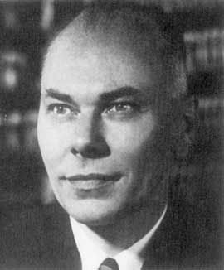
Howard Aiken (1900 – 1973)
http://commons.wikimedia.org/wiki/File:Aiken.jpeg
Notes:
Aiken got a Ph.D. from Harvard in physics in 1939.
During his time, he had to solve differential equations.

Slide 46
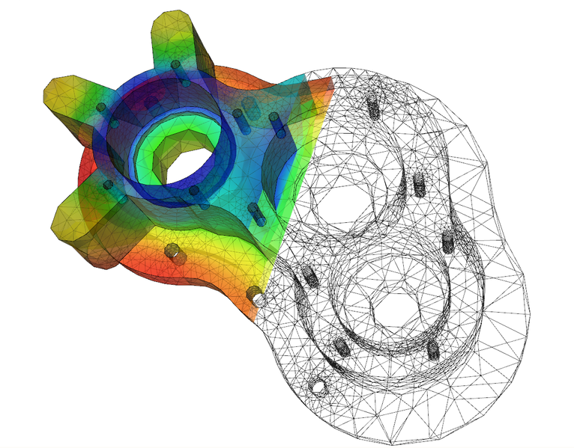
Differential Equations
http://commons.wikimedia.org/wiki/File:Elmer-pump-heatequation.png
Notes:
I had to take one course in dif eq, were it not for computers, I would never have passed that class.
Aiken didn’t have computers to help him.
I don’t remember much about dif eq, so I put this impressive looking graphic from the Wikipedia page in lieu of any coherent explanation.
Guess what: Aiken found these calculations tedious, error prone, and time consuming. So he proposed an Automatic Calculating Machine to IBM, and drew on Charles Babbage for inspiration.

Slide 47
Howard Aiken quote: “The desire to economize time and mental effort in arithmetical computations, and to eliminate human liability to error is probably as old as the science of arithmetic itself.”
Groves paraphrase: “I’m far too lazy to do all this nonsense by hand.”

Slide 48
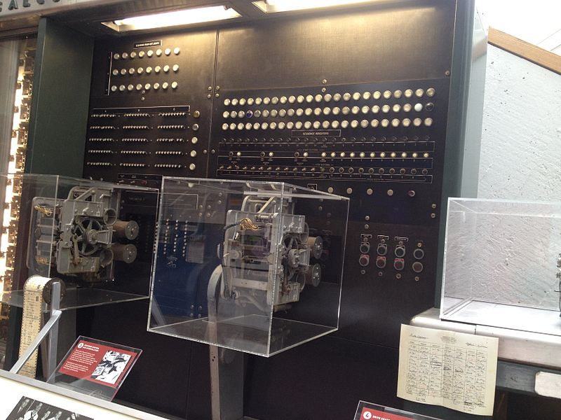
Harvard Mark I
http://commons.wikimedia.org/wiki/File:Harvard_Mark_I_sequencer.agr.jpg
Notes:
That machine became the Harvard Mark I.
The Mark I went into service for the Navy on August 7, 1944.
John Von Neumann came to Harvard in March, 1944 to run a program on it.
Somewhat ironic, because the Mark I originated the “Harvard architecture”, which is in contrast to the Von Neumann architecture.
Harvard architecture, contrast with Von Neumann architecture

Slide 49
Von Neumann vs Harvard
Von Neumann Architecture
Harvard Architecture
CPU
CPU
Memory
Program
Program
Data
Data
Notes:
This is a gross simplification, but these are the architectures.
Notice that Von Neumann, the program and data are both stored in memory. Harvard, they are stored separately.
Von Neumann’s design has the so-called “Von Neumann bottleneck”, since the CPU can either be accessing data or accessing instructions. Harvard can do both at the same time.
There are some workarounds to the Von Neumann bottleneck and there’s a modified Harvard architecture as well.
In modern computers, the Harvard Architecture wins out, but this distinction exists at the CPU cache level.

Slide 50
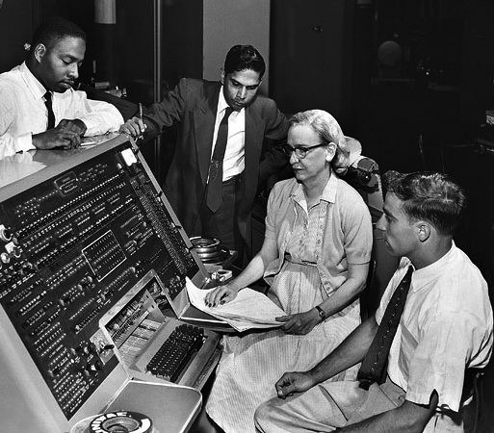
Grace Hopper (1906 – 1992)
http://commons.wikimedia.org/wiki/File:Grace_Hopper_and_UNIVAC.jpg
Notes:
We can’t talk about Aiken without mentioned Grace Hopper, of course.
Grace Hopper had a Ph.D. from Yale in mathematics and was teaching at Vassar until 1941.
In 1941, she left Vassar and joined the Navy Reserve. She was 35 years old and 105 pounds, and enrolled into a Naval Reserve School, graduating first in her class in 1944.

Slide 51
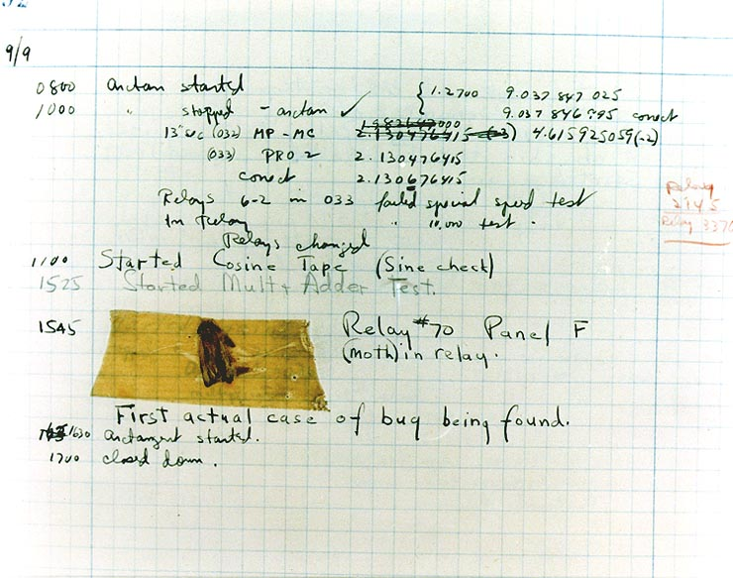
Bug
http://commons.wikimedia.org/wiki/File:H96566k.jpg
Notes:
Literal bug in the system

Slide 52
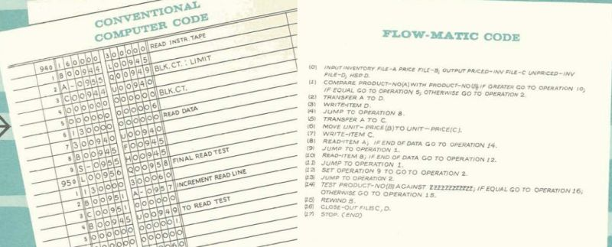
FLOW-MATIC & COBOL
Notes:
It takes a lot more work to read the left than to read the right. I.e. the lazy programmer prefers the right.
Created the first compiler (Zuse designed one but it wasn’t actually created until 1998): "Nobody believed that. I had a running compiler and nobody would touch it. They told me computers could only do arithmetic.“
Created MATH-MATIC and FLOW-MATIC, which lead to COBOL

Slide 53
Point #7
It’s not too late to start being lazy.
Notes:
Grace Hopper had a comfy career at age 35, but with the start of WW2, she realized that she had a more important role to play. She went way out of her way and out of her comfort zone, but she became a legend.
Maybe you won’t become a legend, but don’t fall for the myth that your best work has to be done by so-and-so an age and it’s all downhill after that.

Slide 54
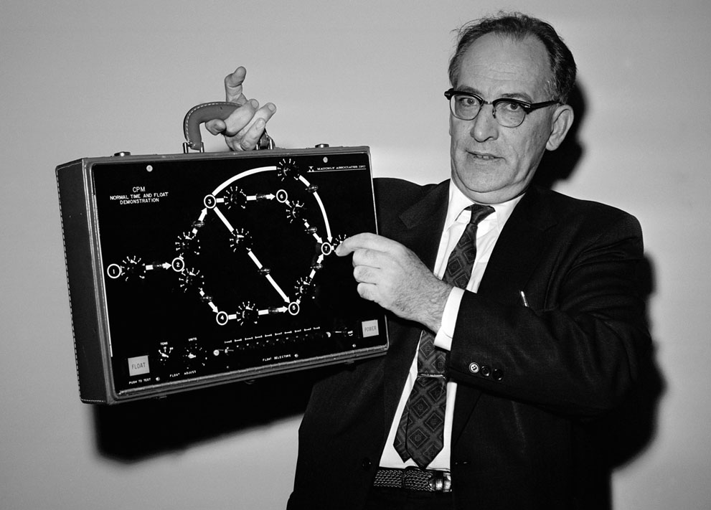
John W. Mauchly (1907 – 1980)
http://www.theatlantic.com/infocus/2012/05/50-years-ago-the-world-in-1962/100296/#img03
Notes:
“Mock-lee”
Mauchly was teaching physics at Ursinus College
This was a small college and couldn’t afford state of the art lab equipment, which was frustrating.
For instance, he was able to access huge amounts of meteorological data, but lacked tools to analyze it (later on he would use UNIVAC to do it)
This led Mauchly into looking in better ways to use technology, both for him and his students.
Mauchly eventually left Ursinus, and took a job as a computer in 19
In this picture, 1962, he’s holding a suitcase sized computer. He predicts that everyone will be walking around with a PC in 10 years.
36.

Slide 55
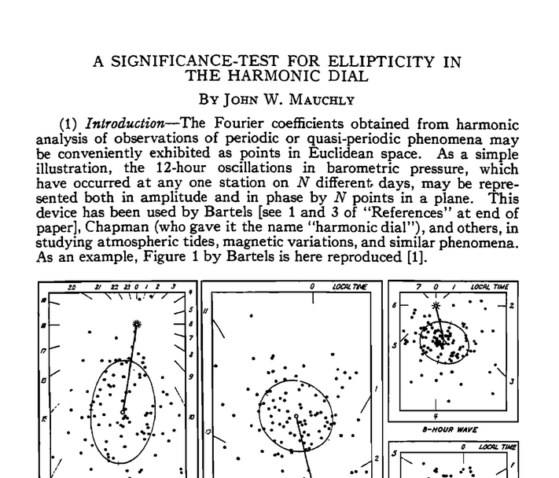
Lazy? Yes.
http://www.readcube.com/articles/10.1029/TE045i002p00145
Notes:
While working as a computer, he wrote a paper, submitted to a journal.
It was rejected because he used too short of a period of data. That’s right, he was too impatient or lazy.
He may have been trying to make a point. Or he may have been trying to get early feedback without have to go through the tedious process of collecting and analyzing a lot more data.
This just fueled him to explore more about automatic computing, because he didn’t want to do all that menial work.

Slide 56
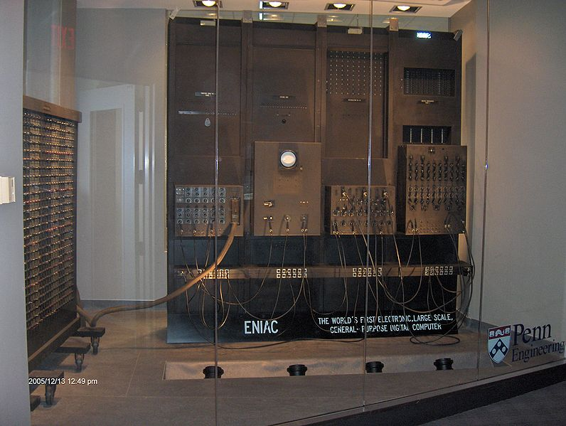
ENIAC
http://commons.wikimedia.org/wiki/File:ENIAC_Penn1.jpg
Notes:
He eventually took a course at University of Pennsylvania, met John Eckert, and began collaborating on electronic computation, which would be much faster than mechanical computation and certainly faster that human computation.
The Moore School received military contract to help with ballistics computations. This led them to create ENIAC.
ENIAC

Slide 57
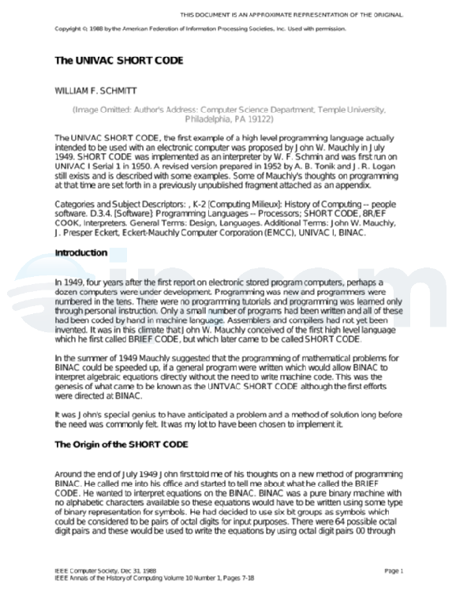
Short Code
http://priorart.ip.com/IPCOM/000129539/
Notes:
ENIAC led him to propose "Short Code“, an interpreted language that would run on the later UNIVAC computer.
It ran about 50 times slower than machine code, so you can thank Mauchly for all those compiled vs interpreted purse fights.

Slide 58
Point #8
Even in failure, be lazy.
Notes:
The way to fail lazily is to fail fast and fail often.
The faster you fail, the faster you succeed.
Continuous integration, pair programming.

Slide 59
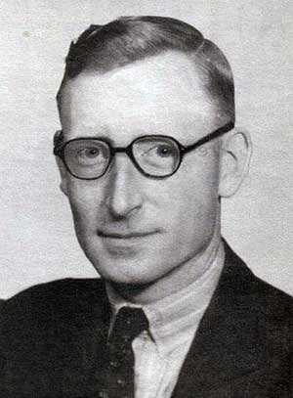
Tommy Flowers (1905 – 1998)
http://commons.wikimedia.org/wiki/File:Tommy_Flowers.jpg
Notes:
Famously worked at Bletchley Park, with Alan Turing and the rest.

Slide 60
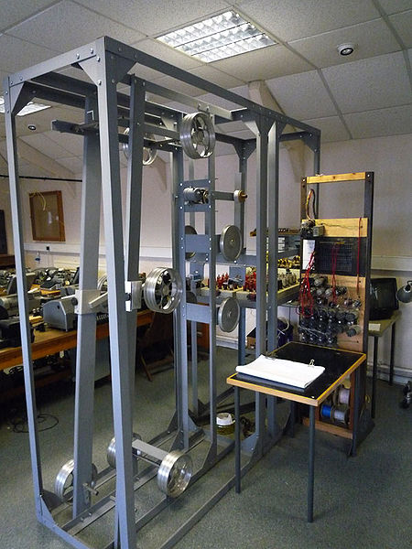
The Heath Robinson
http://commons.wikimedia.org/wiki/File:Heathrobinsonmachine_tnmoc.jpg
Notes:
One of the codebreaking devices created at Bletchley Park was the Heath Robinson.
Tommy Flowers built the "combining unit" for this machine. This module used vacuum tubes (the British call them "valves") to implement boolean XOR logic.

Slide 61
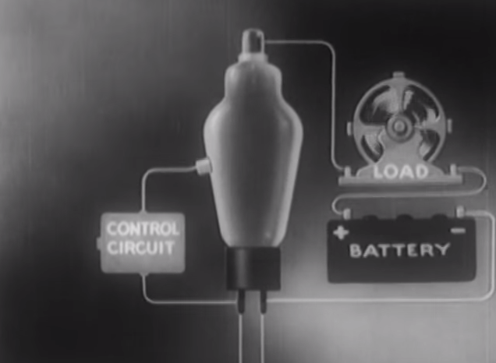
Vacuum Tubes
https://www.youtube.com/watch?v=2eDb8ojvreo
Notes:
Vacuum tubes or “valves” to the English
One thing you can do with a vacuum tube is make it act like a transistor, which in turn is way faster than a relay
The problem is: they take up a lot of space, they’re fragile and need replaced a lot

Slide 62
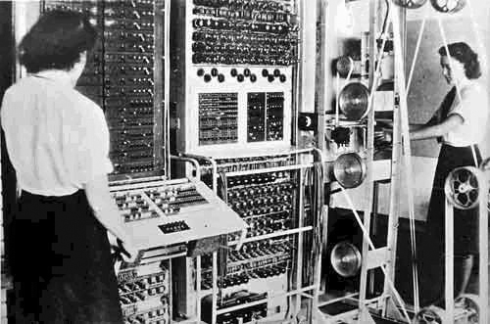
Colossus
http://commons.wikimedia.org/wiki/File:Colossus.jpg
Notes:
Flowers is most famous for the design and creation of Colussus, which is often considered to be the first electronic, programmable computer.
He proposed to build a machine used around 2000 vacuum tubes, which is over 10 times as many as other electronics (like RADAR) used and put reliability into doubt: they often broke and/or just wore out. That's a headache when you depend on a handful of tubes; it's debilitating with thousands. However, Flowers previous work with vacuum tubes caused him to believe that keeping the tubes running continuously was key to improving their reliability.
However, Bletchley decided to turn down Flower’s proposal because of the valves and that it would take too long.
But, he built it anyway. And when it was built, it amazed everyone with its speed and accuracy, and by the end of WW2 there were 10 Colossuses being used.

Slide 63
Point #9
When what “everyone knows” is wrong, prove that your lazy way is correct.

Slide 64
Point #9b
“It is better to beg forgiveness, than ask permission.”
-Grace Hopper

Slide 65
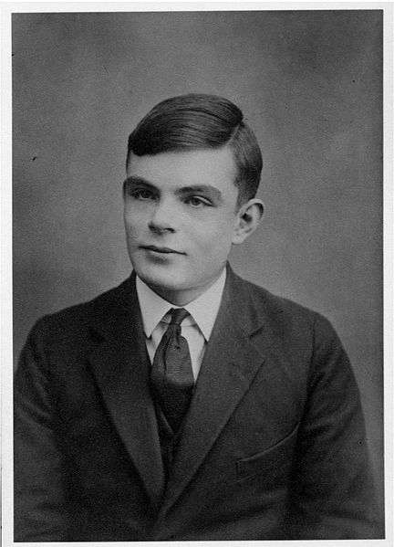
Alan Turing (1912 – 1954)
http://commons.wikimedia.org/wiki/File:Alan_Turing_Aged_16.jpg
Notes:
Another Bletchley Park codebreaker.
Hypothetical device called the Turing Machine
Turing and Knox started to work on a less fragile approach to the problem.^{[47]} The Polish method relied on an insecure indicator procedure that the Germans were likely to change, which they did in May 1940. Turing's approach was more general – created the Bombe

Slide 66
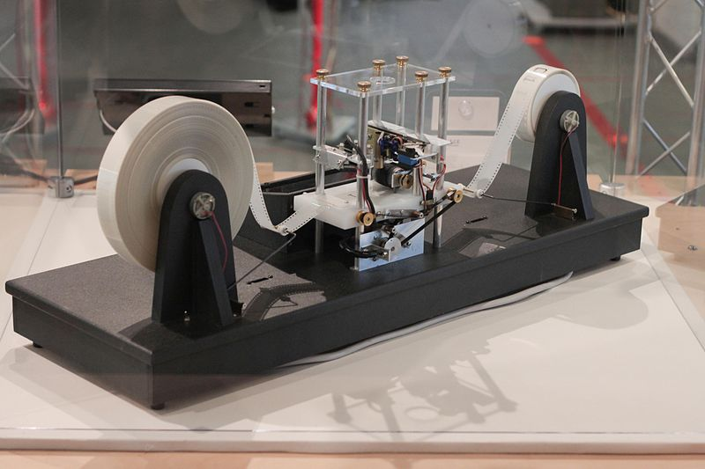
Turing Machine
http://commons.wikimedia.org/wiki/File:Turing_Machine_Model_Davey_2012.jpg
Notes:
Turing machine is a hypothetical device, part of the Church-Turing thesis, and a crucial and fundamental concept in computer science

Slide 67
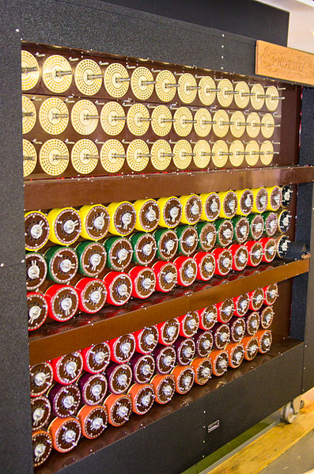
Bombe
http://commons.wikimedia.org/wiki/File:Bletchley_Park_Bombe4.jpg
Notes:
The Polish created a “bomba” device which worked to decrypt German Enigma messages. However, it only worked through an exploit. If that exploit was “patched” by the Germans, it would stop working.
Turing proposed a more general system, and went to work on adapting the Polish work in September, 1939.
In May 1940, the Germans did “patch” their system.

Slide 68
Point #10
Aspire to future laziness.
Notes:
The Polish codebreakers perhaps weren’t lazy enough.
Change is going to happen. Anticipate what’s likely to change the status quo. If you start to work on that now, it will be less work than putting it off until later.

Slide 69
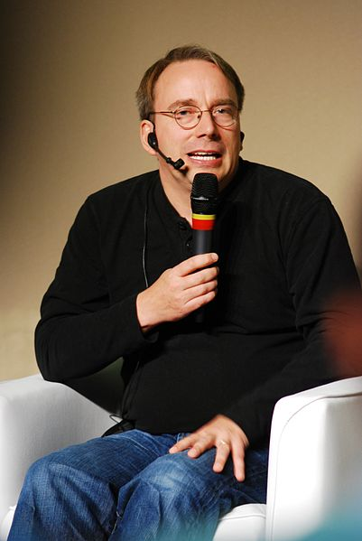
Linus Torvalds (1969 - )
http://commons.wikimedia.org/wiki/File:Linus_Torvalds_-_Linuxcon2011.jpg
Notes:
Linus, when creating Linux said that if GNU kernel was available, he wouldn’t have written his own. If 386BSD was available, he wouldn’t have created Linux.
Torvalds wasn’t originally going to call it “Linux“ since it was too egotistical.

Slide 70
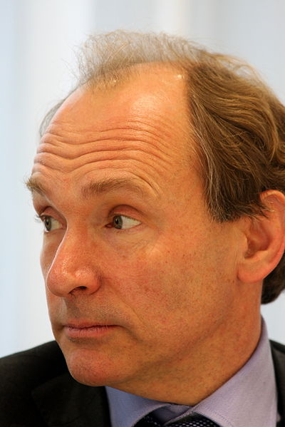
Tim Berners-Lee (1955 - )
http://commons.wikimedia.org/wiki/File:Tim_Berners-Lee_closeup.jpg
Notes:
“I just had to take the hypertext idea and connect it to the TCP and DNS ideas and—ta-da!—the World Wide Web”
Creating web was an “act of desperation”, because while working with students, their work and ideas could be *linked* to, to provide a big collaborative set of documentation that could live on even if the students weren’t debriefed when leaving CERN.

Slide 71

Gregor Kiczales (1961 - )
http://commons.wikimedia.org/wiki/File:Gregor_Kiczales_AOSD.jpg
Notes:
Finding bugs in OOP that are caused by cross cutting concerns.
Kiczales and his team at PARC determined that there wasn’t a technique to capture these cross-cutting designs or to cleanly implement them.
So they created “aspects” and “aspect oriented programming”

Slide 72
Point #11
Don’t wait for the right tool to help you (laziness), build a tool to solve your problem (virtuous laziness).
Notes:
This is really the point of all points.
None of these people *had* to do what they did. They could have been satisfied with the status quo.
But if they weren’t lazy, ships would be lost at sea more often, WW2 would have lasted longer, and “computers” wouldn’t have been unemployed so soon.

Slide 73

You & me (19?? -)
http://pixabay.com/en/silhouettes-boy-girl-kids-young-28769/
Notes:
Probably none of us will get our own Wikipedia page
But each of us are writing history every day.
Kathleen Dollard said earlier at CodeMash that we are part of one of the most important story arcs in history.

Slide 74
Here’s what I want to do…
Be lazy, but be productive.
Work hard, but don't waste time.
Be empowered, but don't be perfect.
Start now, but leverage the past.
Use more umlauts.
Notes:
Take what you will from this session. I hope I showed you something you didn’t know. Someplace to start your own study of history.
But here’s what I’ve taken away from my study, and some small ways that I can apply them, because I’m not John Von Neumann or Grace Hopper.
Heuristic Solutions: it’s right in our name, an heuristic is like an empirical shortcut.
If I’m thrashing on a problem, take a break instead of trying to grind it out.
When I really want to start using AOP or introduce a new functional test framework, then I should do it. I may have to do it on my own time. I need to be prepared to be wrong, or to throw away my first attempt.
I’ve spent time on projects and technologies that I know were outdated, broken, niche. At the time, I just wanted to get a project behind me, but the book I wrote was born out of a project within a broken organization using terrible technology.

Slide 75
AOP in .NET http://manning.com/groves 42% off code: 12mp25
Contact me:
http://crosscuttingconcerns.com
http://about.me/mgroves

